Slide 1
Of Whom We Hold Dear
Group 1
-Matthew Allum
-Aaron Mulligan

Slide 2
Audience/Logline
Take control and experience an ageing MC struggling with anterograde amnesia. Help him discover what he’s lost and find the truth behind his accident.
PC platform – First person perspective
Teens/Young males ~ females
Notes:
Audience/Logline
We will need to discuss who the character will be (example: Gender, age, anything about them unless we’re making it so the player is the character)
Sporadic productivity, will need to have a definition of what it means for the audience for them to have an understanding of what it means.
Could maybe turn the beginning of the logline into a rhetorical question, example: “Ever wonder what really happens to that one person who holds up a game lobby?”
Following it up with: “Come find out by playing as [character] who suffers from sporadic productivity who must complete menial tasks at the expense of others”

Slide 3
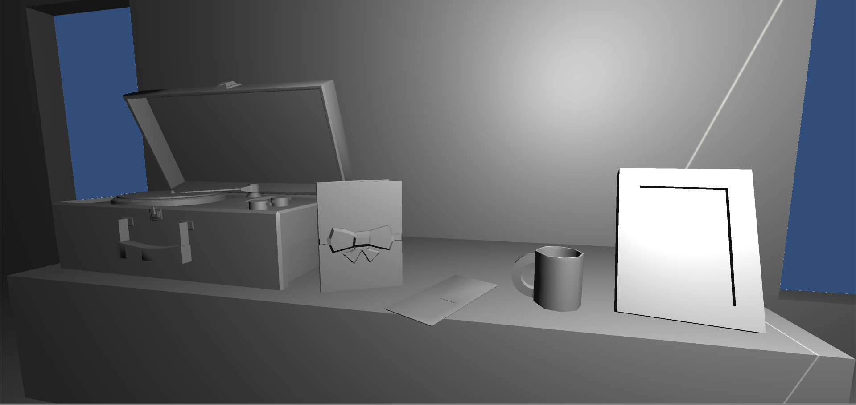
Prototype Game

Slide 4
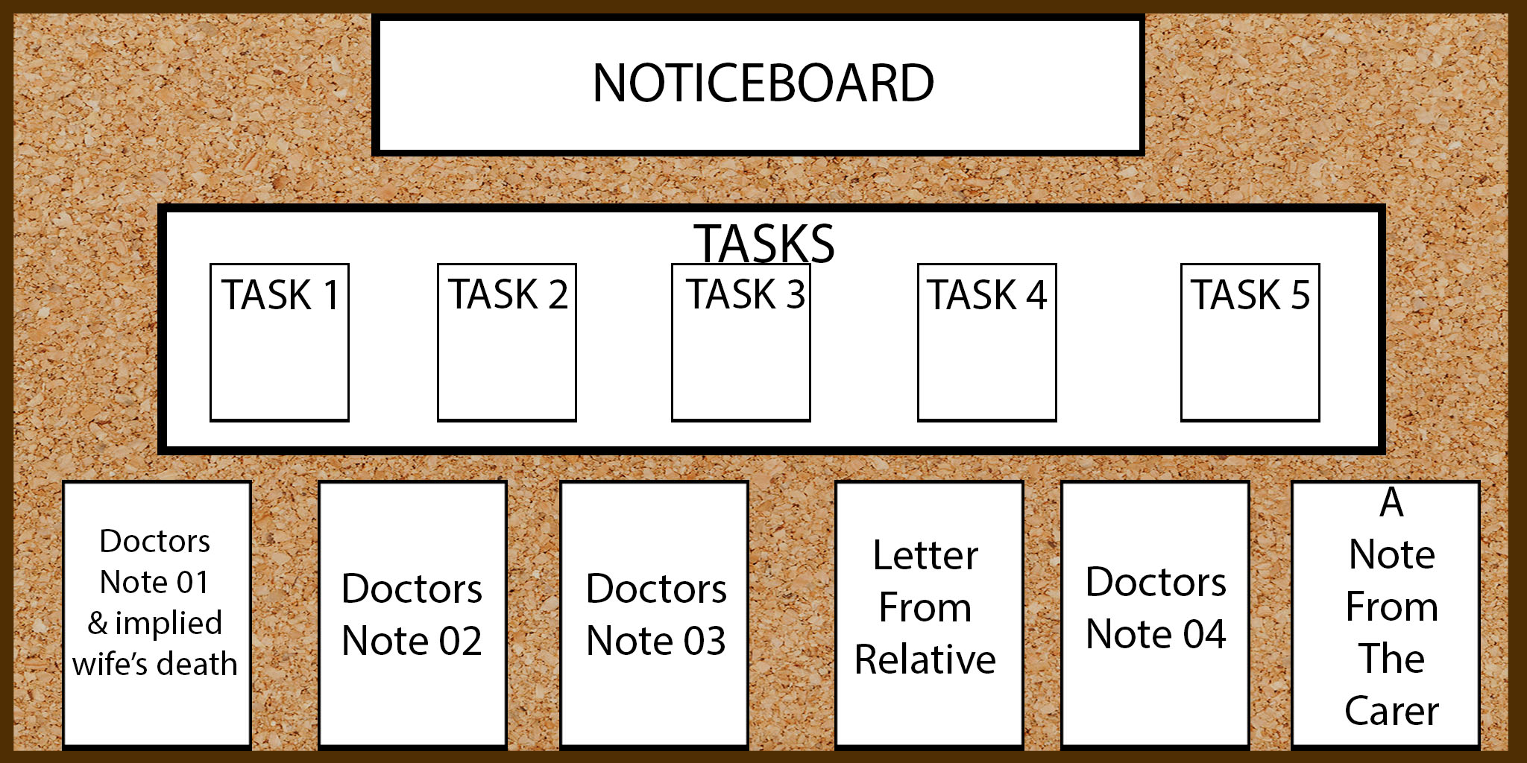
Noticeboard
Central hub for the player to go to
Displays objectives, lore and instructions
Updates as player progresses

Slide 5


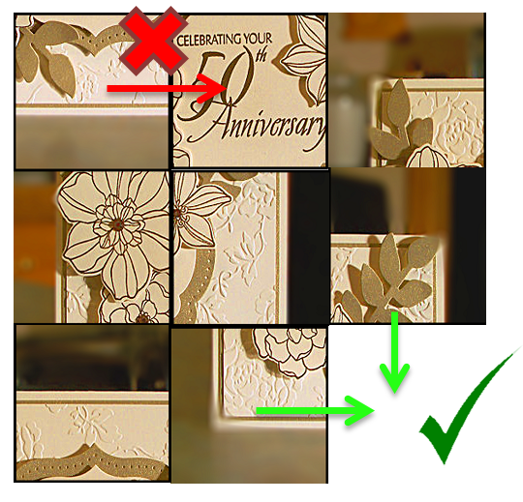
Sliding Box Puzzle
Players seek specific items (noticeboard)
Once found players must complete sliding box puzzle
Progress saved if player exits prematurely – randomizes if caught

Slide 6
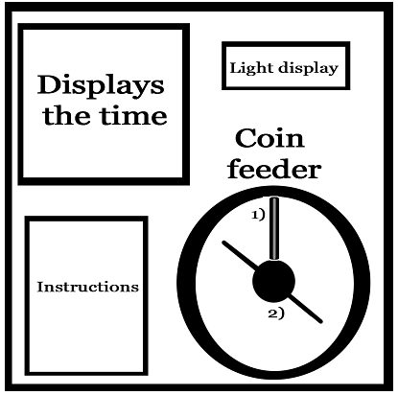
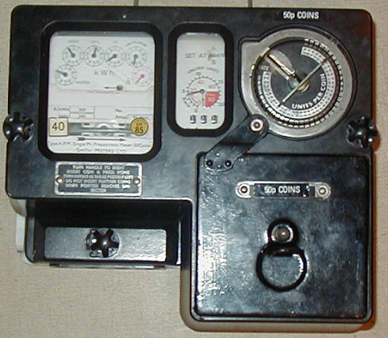
Fuse Box Management
Old coin meter fuse box – feed coins for electricity
Coins are limited – higher value coins give more time
Strategy behind what coins to use when
Insert coin then crank handle to
Start-up.

Slide 7
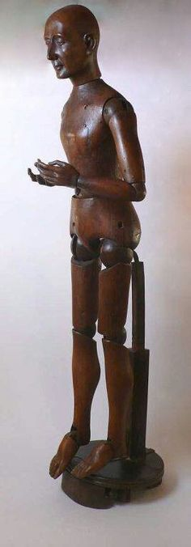
The Carer
Perceived threat when in interface & when lights are off
Follows systematic path through house to allow strategizing
Designed as a mannequin – Player feels as the MC feels

Slide 8
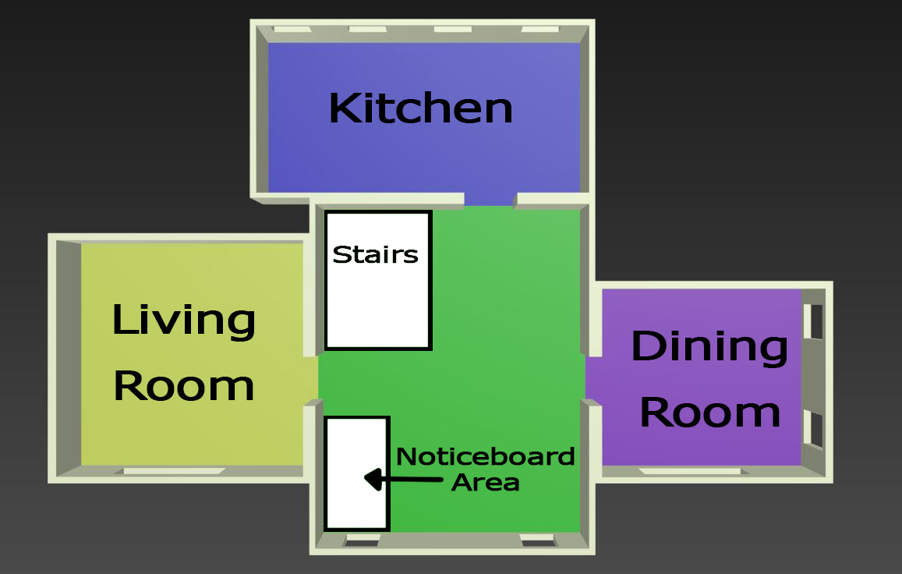
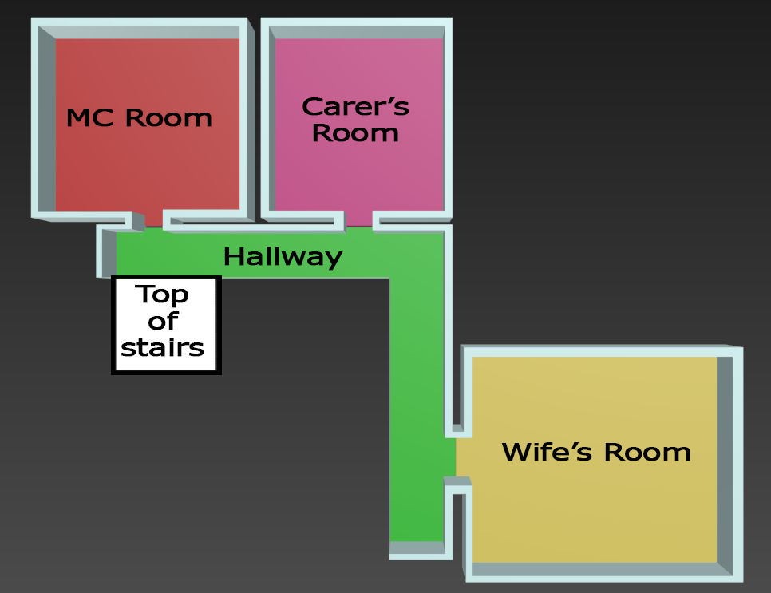
Floor Plan
Bottom Floor
Top Floor

Slide 9

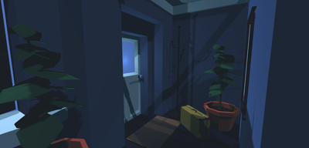
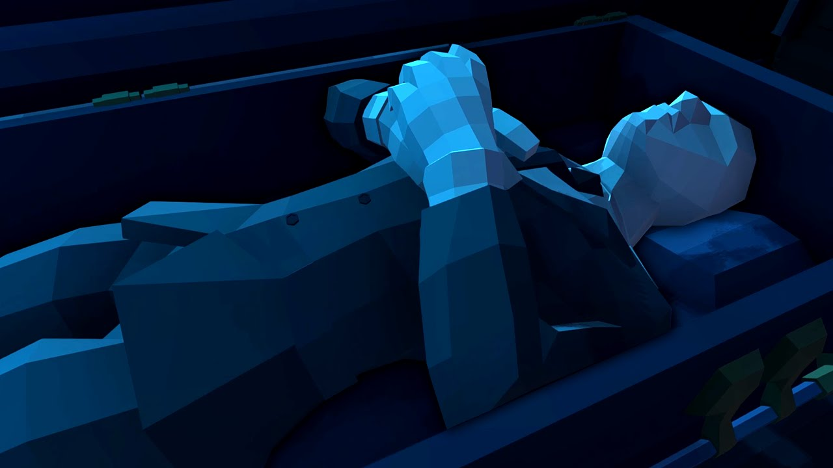
Art Style
Low Poly Angular Assets (Torpor)
Greater control of the visual hierarchy
Allows us to distinguish player objectives better
Realistic for a two man team

Slide 10
Future Tasks
Get the core mechanic into the game
Get the fuse box management into the game
Start creating The Carer in the game

Slide 11
Questions?

